Slide 1

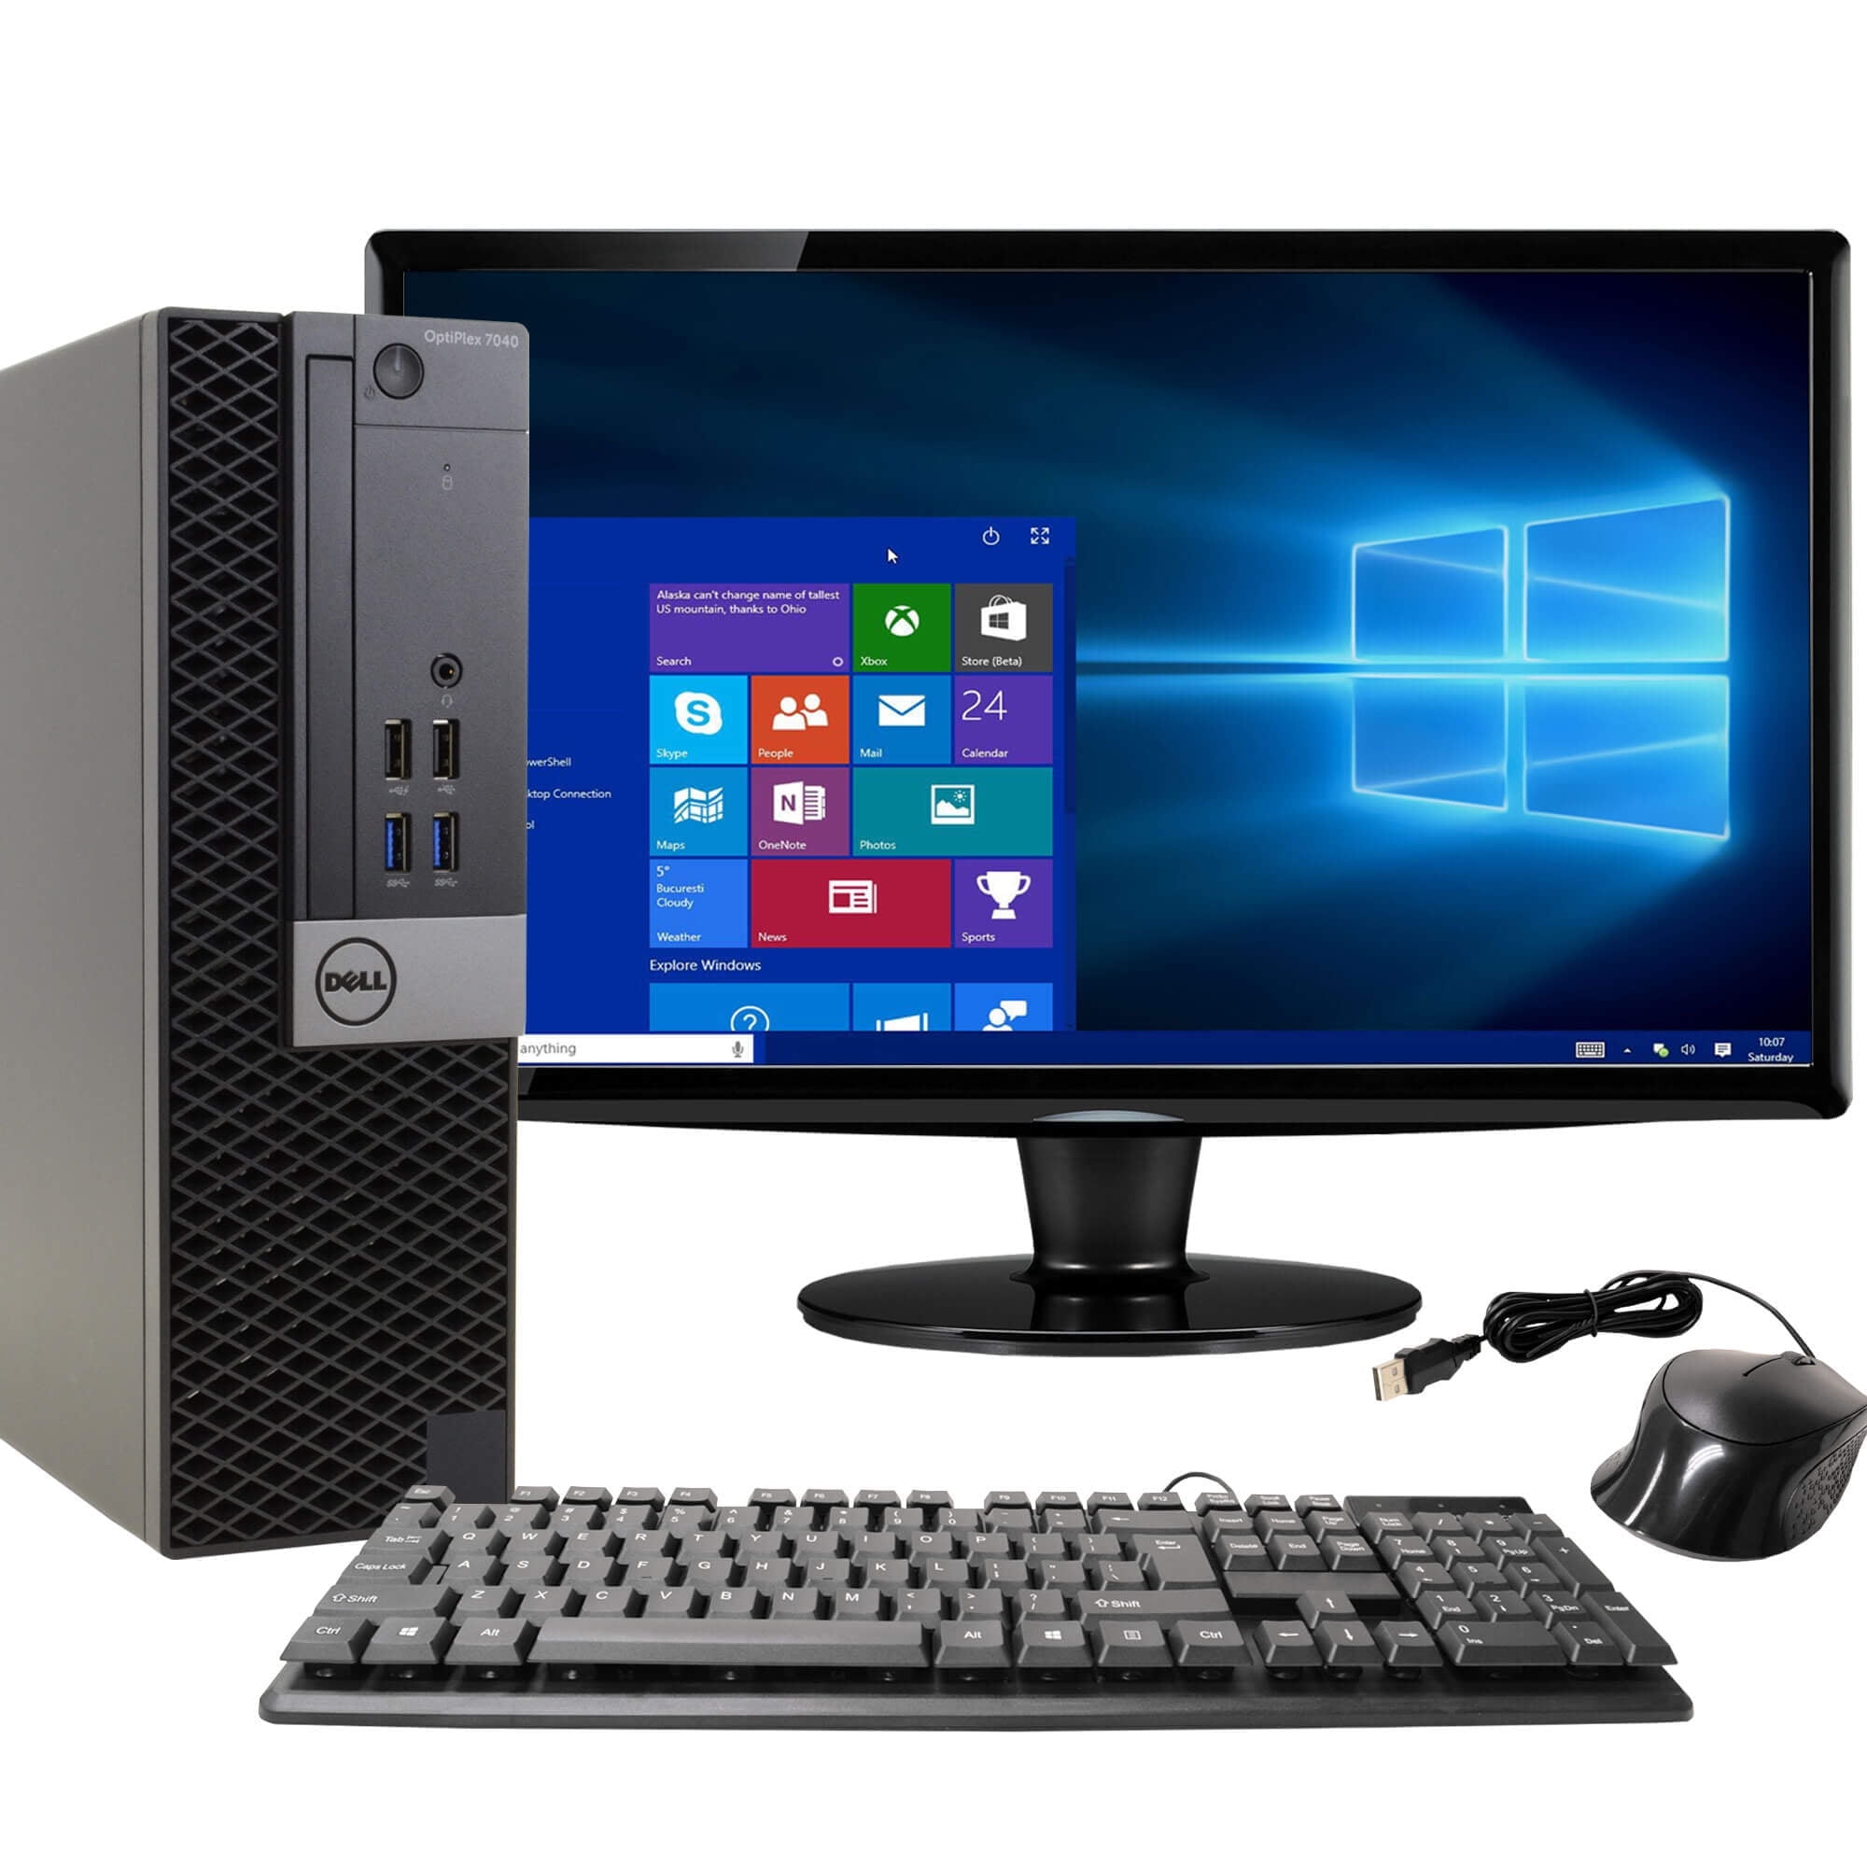
COMPUTER SYSTEM

Slide 2

What is Computer ?
A computer is an electronic device that manipulates information, or data. It has the ability to store, retrieve, and process data. You may already know that you can use a computer to type documents, send email, play games, and browse the Web. You can also use it to edit or create spreadsheets, presentations, and even videos.

Slide 3

COMPUTER FULL FROM :-
C – Common
O – Operating
M – Machine
P – Purposely
U – Used for
T – Technological
E – Educational
R - Research

Slide 4

TYPES OF COMPUTER
There are two bases on which we can define the types of computers. We will discuss the type of computers on the basis of size and data handling capabilities. We will discuss each type of computer in detail. Let’s see first what are the types of computers.
Super Computer
Mainframe computer
Mini Computer
Workstation Computer
Personal Computer (PC)
Server Computer
Analog Computer
Digital Computer
Hybrid Computer
Tablets and Smartphone

Slide 5

A personal computer provides computing power to one user. Learn about the various types, their components and uses.

